Slide 1

MISUSE/ OVERUSE/ABUSE OF INTELLECTUAL PROPERTY RIGHTS

Slide 2

Introduction
If an Intellectual Property owner improperly uses the Intellectual Properties beyond its lawful scope, the Intellectual property is consider to be improperly used or misused.
Example: Patent misuse includes illegal tying of products and services to the patented invention, price fixing and the like.

Slide 3
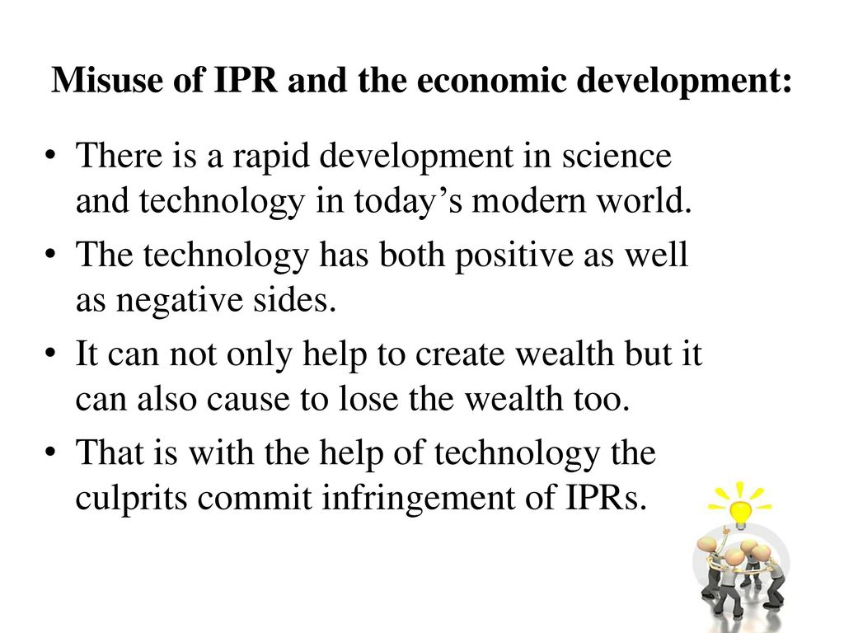

Slide 4
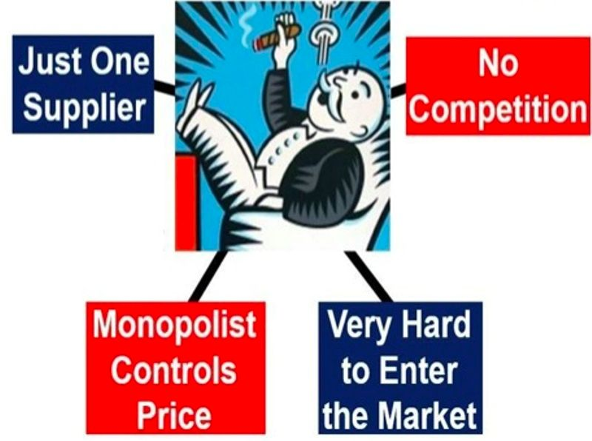
Causes of Misuse/Overuse IPR
Monopoly pricing
Restrictions on end users
Territorial restraint
Exclusive dealings

Slide 5
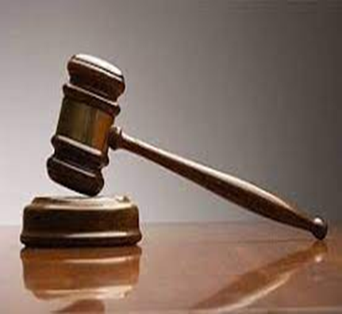
Reasons to Prevent Abuse/ Misuse of IPR
Article 31 of TRIPs provides for the grant of compulsory licenses, under a variety of situations, such as:
The interest of public health
National emergencies
Nil or inadequate exploitation of the patent in the country
Anti-competitive practices by the patentees or their assignees
Overall national interest
Prevention of monopoly

Slide 6
Methods to prevent misuse of IPR
There are generally two approaches that have been adopted to prevent IPR abuse:
Compulsory licensing : An involuntary contract between a willing buyer and an willing seller imposed and enforced by the state.
Parallel imports : goods brought into a country without the authorization of the patent, trademark or copyright holders after those goods were placed legitimately into the market elsewhere.

Slide 7

Methods to prevent misuse of IPR
Compulsory Licensing: Compulsory licensing is required to prevent patented product or process.
IP Law enforcement
Imposing huge penalties
Cancelation of licensing
Imprisonment
Banned from the doing business

Slide 8
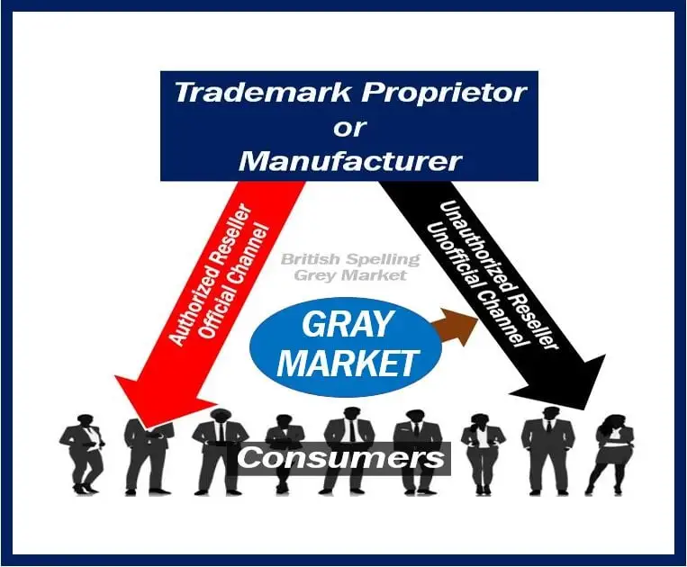
Methods to prevent misuse of IPR
Parallel Imports: The term “parallel imports” (also known as “gray market goods”) refers to genuine branded goods obtained from one market (i.e., a country or economic area) that are subsequently imported into another market and sold there without the consent of the owner of the trademark.

Slide 9
Compliance and Liability Issues of IPR:
Intellectual Property is likely to produce or use may intangible assets, such as computer programmes, literary or artistic works (e.g., images or literary descriptions), databases, valuable raw data, algorithms, industrial recipes etc.
The Intellectual Property legal framework is thus crucial in order to, on the one hand, secure its own investment and on the other, to avoid the infringement of Intellectual Property of others.
As regards protection of valuable intangible assets generated by a system, one needs to consider traditional IP protection, such as patents and copyright. Additionally, the legal framework for the protection of business confidential information and trade secrets is important. Intellectual Property rights are regulated at the international and national levels.

Slide 10
COMPLIANCE AND LIABILITY ISSUES OF IPR
The European Union has adopted a number of legislative acts relating to the IP. European law complies with the obligations imposed by international law, but at the same time harmonizes IPR further and often provides for a higher standard of protection then international conventions, in particular in the field of copyright.

Slide 11
COMPLIANCE AND LIABILITY ISSUES OF IPR
In the area of copyright protection, harmonisation at EU level is provided mostly by Council Directive 2001/29/EC of 22 May 2001 on the harmonization of certain aspects of copyright and related rights in the information society (Information Society Directive), Directive 06/96/EC on the legal protection of databases (Database Directive), and Directive 2009/24/EC on the legal Protection of Computer Programs (Computer Programmes Directive).
Copyright grants an exclusive right to control reproduction and communication to the public of literary and artistic works, as far as they are original and fixed in some material form.

Slide 12
THANK YOU

